Slide 1
Bell Work: 1.) Write the equation, and graph the line through (-6, 1) and (5, 2) Find the slope, y-intercept, domain and range.

Slide 2
From Last Time…
New Material
Page 86 #1, 11, 17, 19, 27, 32
Mixed Review
Page 88 #60, 62, 66, 67

Slide 3
ALGEBRA 3
Day 18

Slide 4
Chapter 2 Section 5 Using Linear Equations
Objective: Identify correlation and write equation of best fit
Chapter 2 Section 6 Families of Functions
Objective: Describe the transformation from the parent graph

Slide 5
Chapter 2 Section 5 Using Linear Equations Vocabulary
Scatter Plot – graph used to determine if a relationship exists between paired data
Positive Correlation—y increases as x increases
Negative Correlation—y decreases as x increases
Relatively No Correlation—no linear pattern

Slide 6
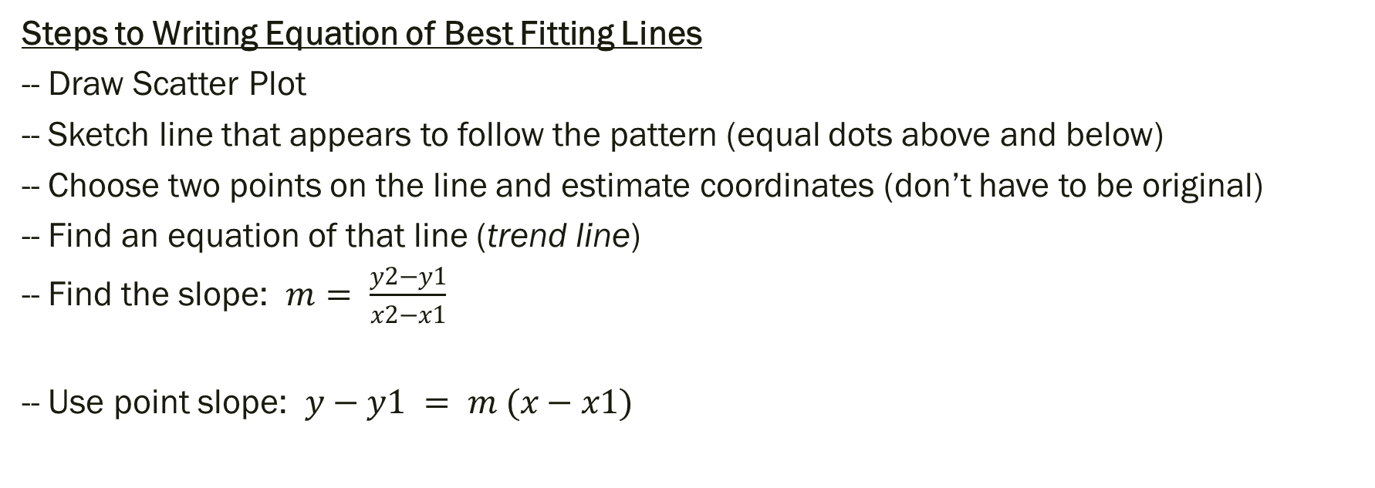
Write the Equation of a Line of Best Fit
Steps to Writing Equation of Best Fitting Lines
-- Draw Scatter Plot
-- Sketch line that appears to follow the pattern (equal dots above and below)
-- Choose two points on the line and estimate coordinates (don’t have to be original)
-- Find an equation of that line (trend line)
-- Find the slope: $m= \frac{y2−y1}{x2−x1}$
-- Use point slope: $y−y1 = m (x−x1)$

Slide 7
Examples: Describe the correlation and write the equation of the line of best fit for the given data
Below is a table that shows the age of a driver, and the average speed at which they drive.
Age: 16 16 18 18 25 20 28 30 40 60
Speed: 45 48 52 49 42 45 40 38 30 22

Slide 8
Chapter 2 Section 6 Family of Functions Vocabulary
Parent Graph – graph simplest form in a set of functions that form a “family”
Transformation—each function in the “family” that is related to the parent
Translation—type of transformation that shifts parent graph horizontally, vertically, or both without changing the shape of the parent graph

Slide 9
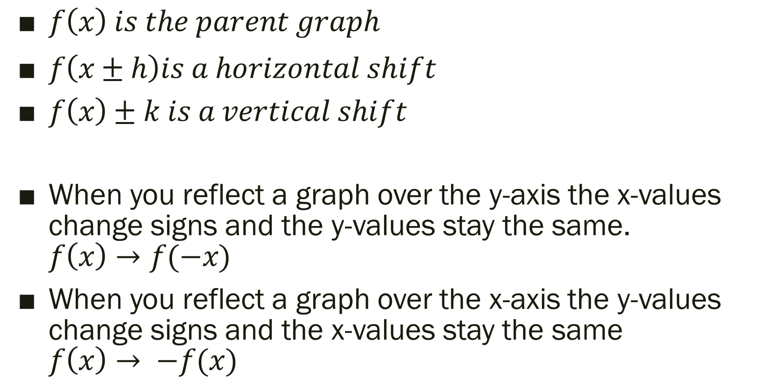
Types of Transformations
$f\left(x\right) is the parent graph$
$f\left(x±h\right)is a horizontal shift$
$f\left(x\right)±k is a vertical shift$
When you reflect a graph over the y-axis the x-values change signs and the y-values stay the same. $f\left(x\right)→f(−x)$
When you reflect a graph over the x-axis the y-values change signs and the x-values stay the same $f\left(x\right)→ −f(x)$

Slide 10

Example (Using Graphing Calculator): Describe the transformation.
Parent Graph $f\left(x\right)=x^{2}$
1.) $f\left(x\right)={(x−4)}^{2}$
2.) $f\left(x\right)=x^{2}+3$
3.) $f\left(x\right)={(x+2)}^{2}−5$
4.) $f\left(x\right)=−5({x−1)}^{2}+6$

Slide 11
For Next Time…
New Material (Section 2.5)
Page 96 #1, 7, 9, 13, 15-17, 27
New Material (Section 2.6)
Page 103 #5, 6, 13, 19-21, 55

